Slide 1
Netflix Stock Price Analysis for 2017
Nikola Andric

Slide 2
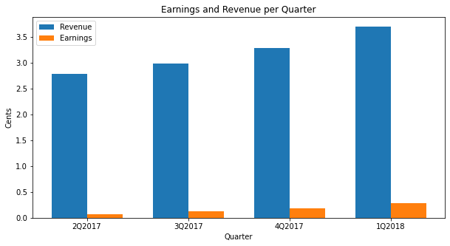
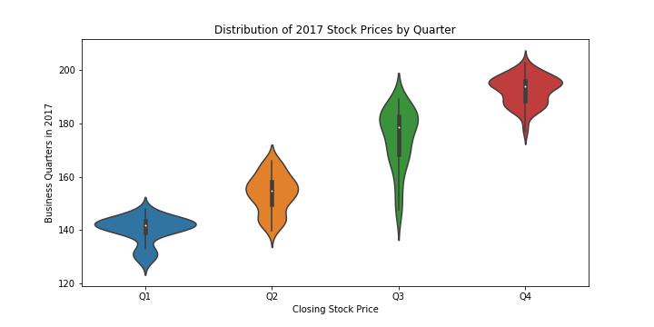
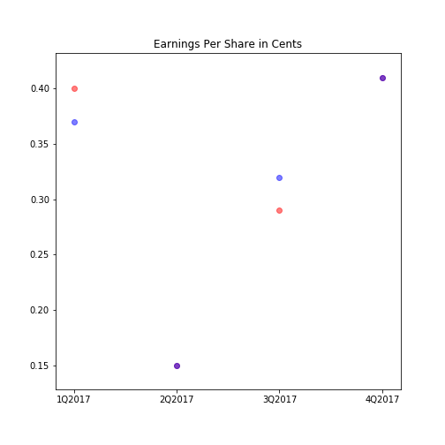
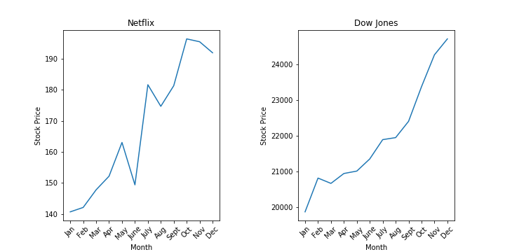
Presentation of the data analysied for Netflix and compared to the Dow Jones Industrial Index

Slide 3
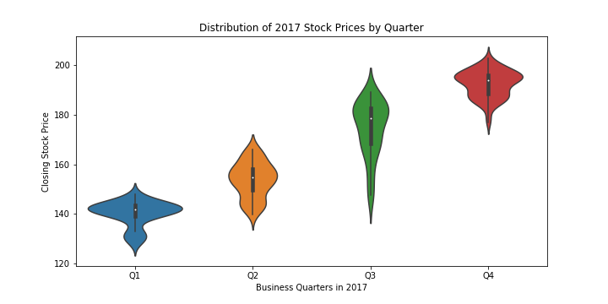
The stocks had a positive growing trend in 2017 and it can be seen even from quarter to quarter. The range of the prices is 128- 203. The lowest price of the year was 127,489998 and the highest 202.679993.

Slide 4
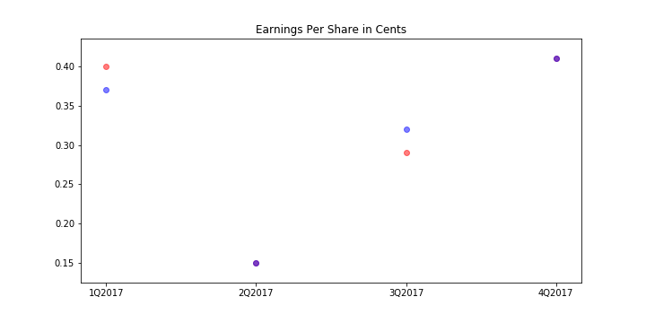
The purple dots represent a good forecast, where the estimates were equal to the actual values, and the goal was achieved. Q3 brough a slight dissapointment where the company earned less than it was forecast, but the rest were either point on or exceeding.

Slide 5
The revenue has a growing trend throughout the quarters. Earnings as well, albeit slower. The percentage of revenue in the earnings ranges from 2.35% in Q1 up to 7.84 in Q4

Slide 6
Both Netflix and DJIA had a rising trend in 2017. Netflix was more volatile with more jumps and falls. Netflix makes up around 0.7% of the DJIA

